Slide 1
Lean Six Sigma Program
OB10 – e-invoicing solution for PTSAs
Revenue Contract Management
Finance division - KAUST
e-invoicing@kaust.edu.sa

Slide 2
OB10 e-invoicing solution for PTSAs
Things to remember
Always submit your invoice & timesheet through your OB10 account. Don’t share your password, this account is specific to you.
You do not have to pay for the registration or sending invoices EVER.
When you submit your invoice through OB10 please provide only the requested information, which we have highlighted in this document (highlighted with a red circle), the other information is not needed.
Before sending an invoice, please make sure:
Invoice number should be your contract number and period of service
Description should be your full name, PTSA and period of service
Currency is changed to Saudi Riyal (or as per your contract)
Number of hours matches with your timesheet
Unit rate matches with your agreement
Timesheet and contract copy is attached as a single PDF file
Timesheet is properly and completely filled and signed by your manager (or for the schools, approved centrally)

Slide 3
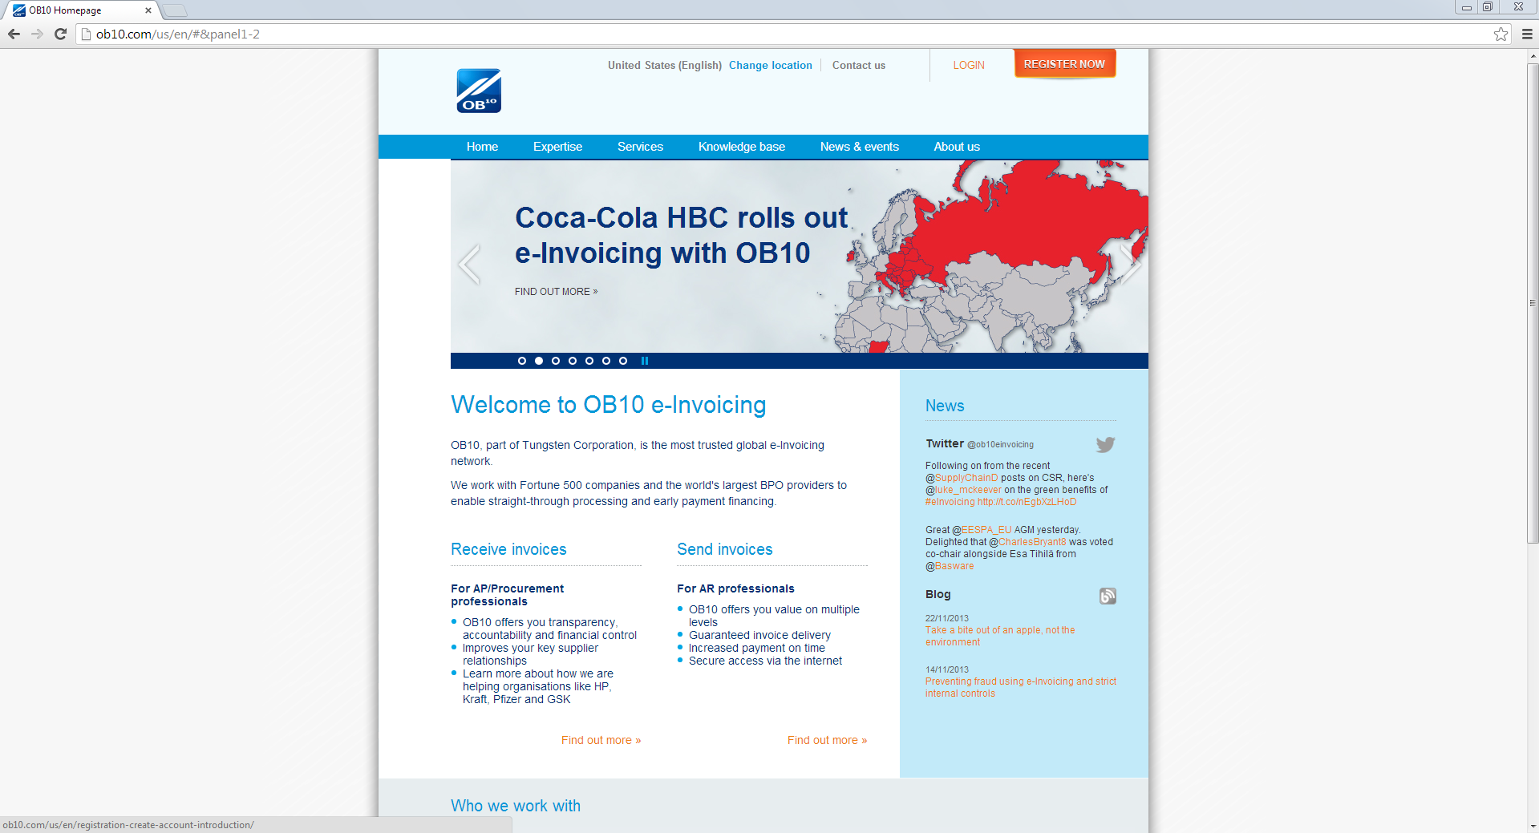
OB10 e-invoicing solution for PTSAs
How to use OB10 vendor portal
www.ob10.com

Slide 4
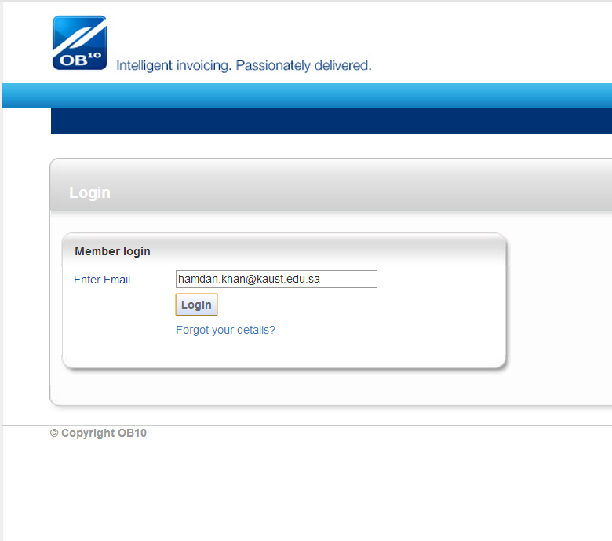
OB10 e-invoicing solution for PTSAs
How to use OB10 vendor portal

Slide 5
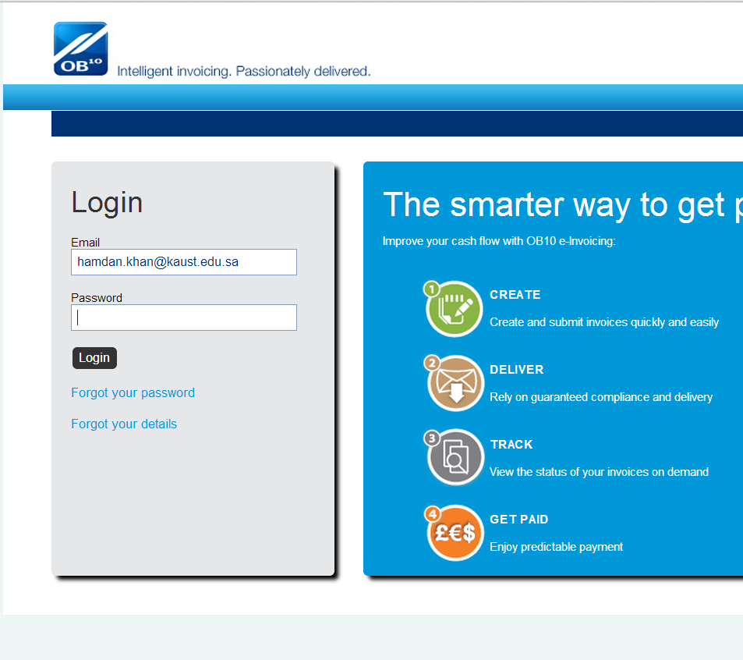
OB10 e-invoicing solution for PTSAs
How to use OB10 vendor portal

Slide 6
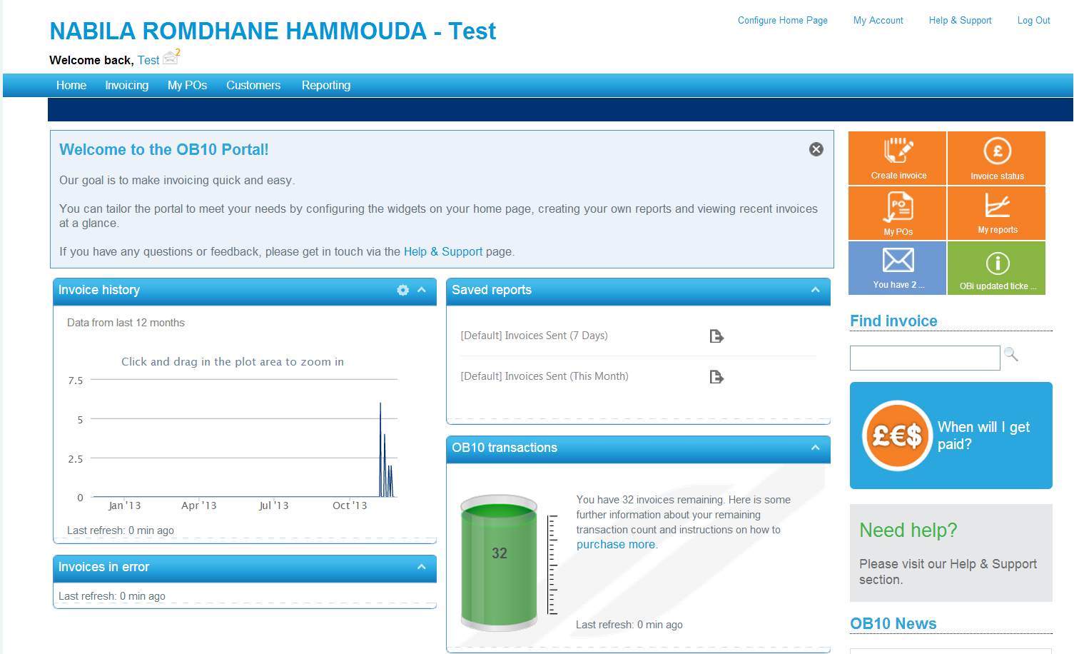
OB10 e-invoicing solution for PTSAs
How to use OB10 vendor portal
YOUR NAME

Slide 7
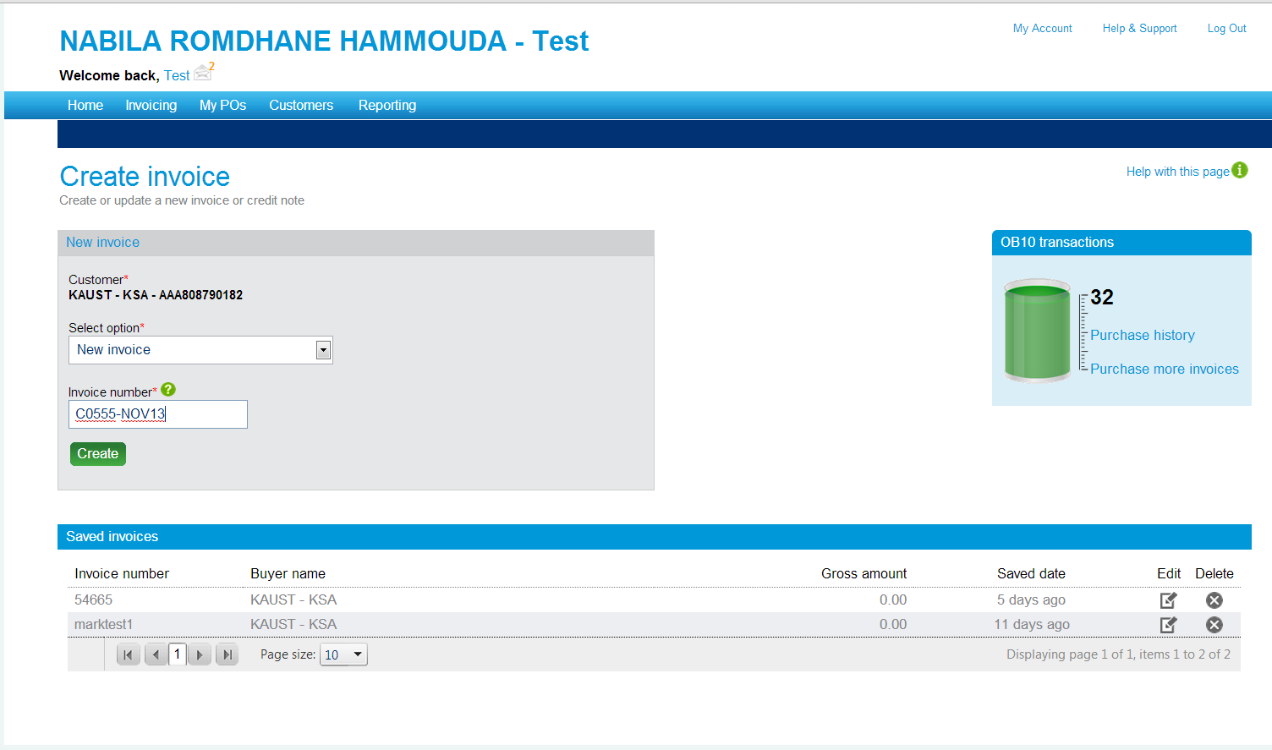
OB10 e-invoicing solution for PTSAs
How to use OB10 vendor portal
YOUR NAME

Slide 8
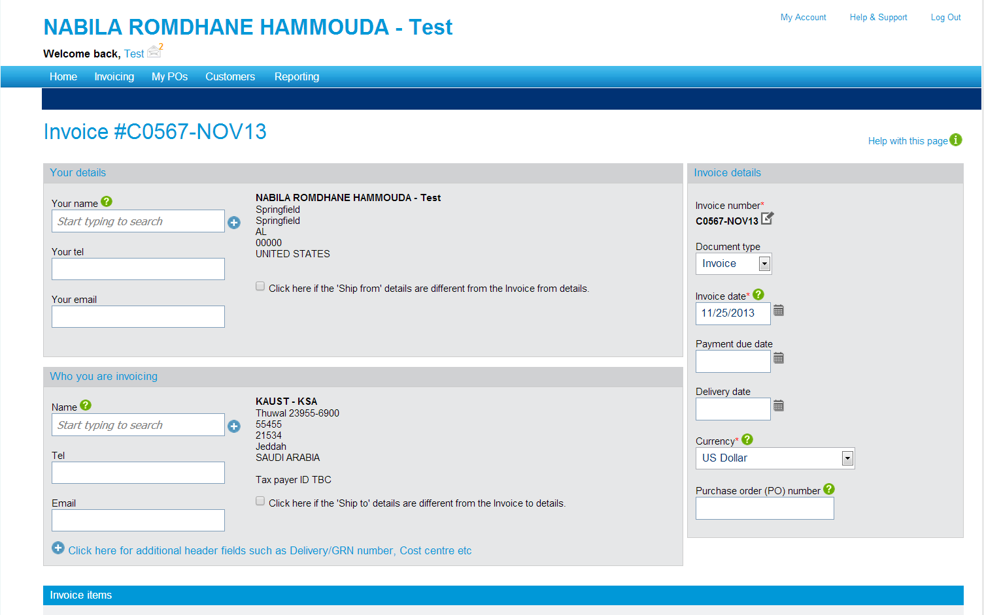
OB10 e-invoicing solution for PTSAs
How to use OB10 vendor portal
YOUR NAME

Slide 9
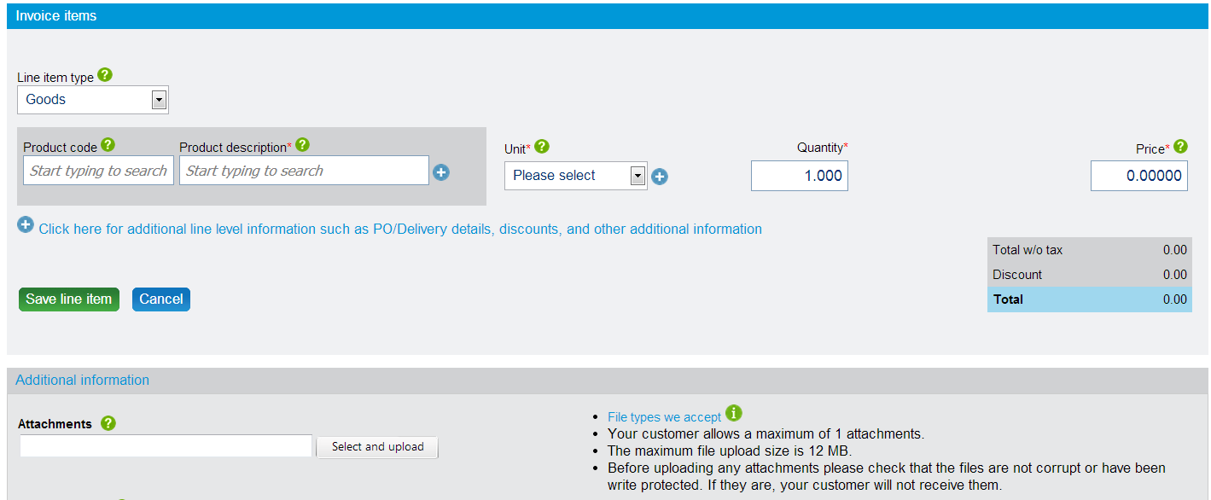
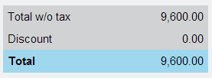
OB10 e-invoicing solution for PTSAs
How to use OB10 vendor portal

Slide 10
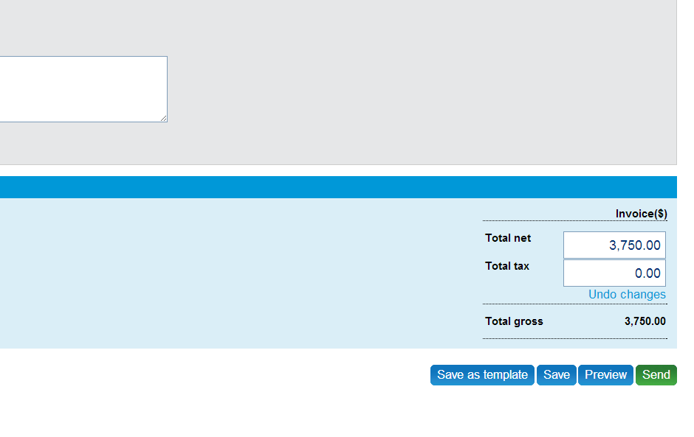
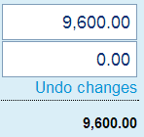
OB10 e-invoicing solution for PTSAs
How to use OB10 vendor portal

Slide 11
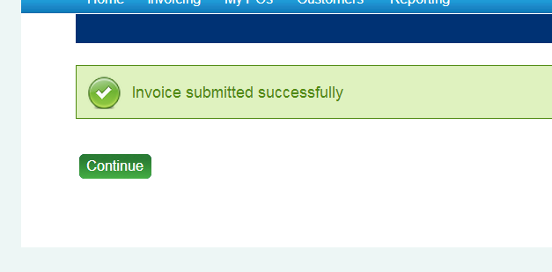
OB10 e-invoicing solution for PTSAs
How to use OB10 vendor portal

